Slide 1

Patrones Hermosos

Slide 2
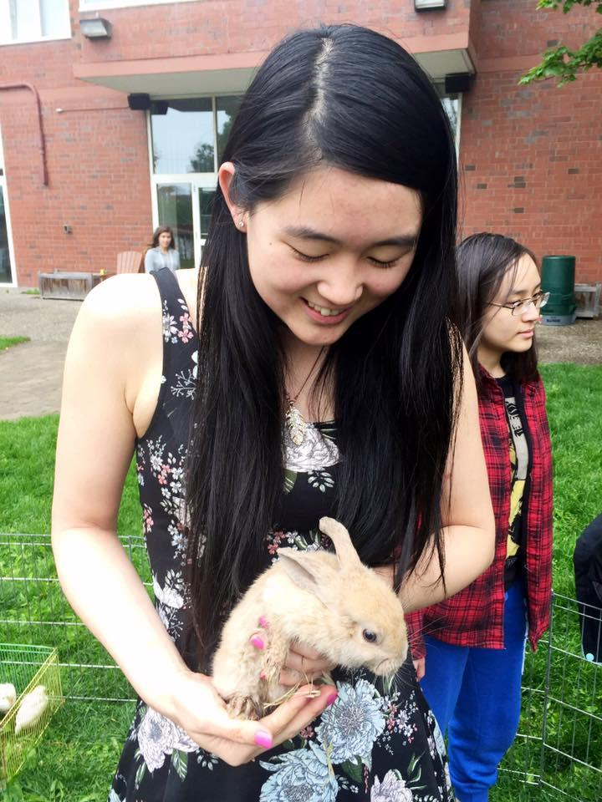



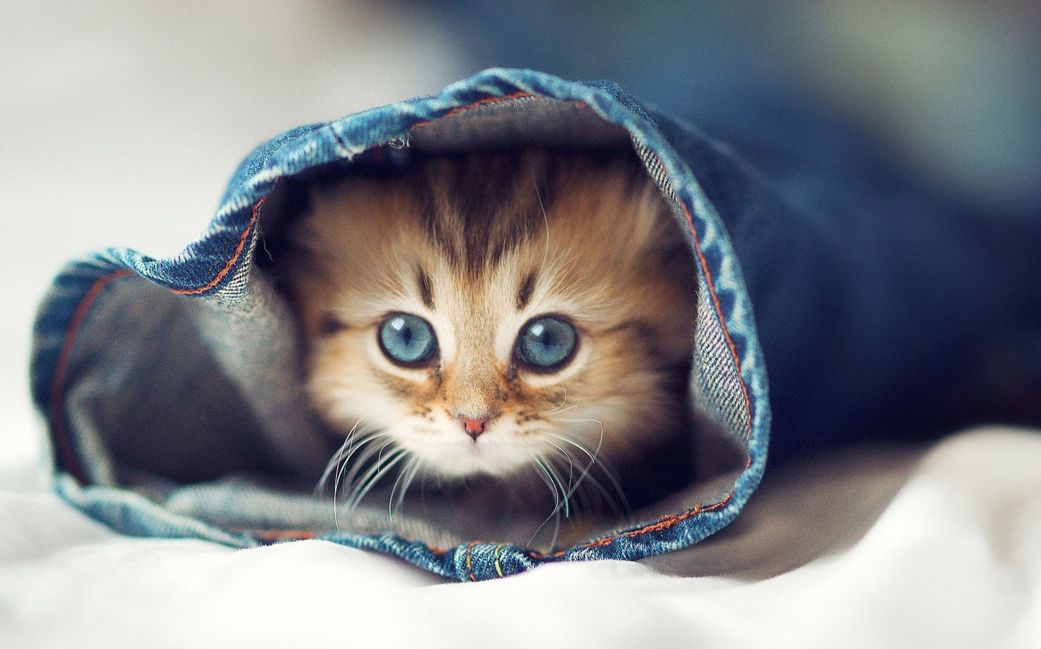


Meet Maddy!

Slide 3
Meet Your TAs!

Slide 4
Now Your Turn :)
Name
Favorite animal
Why are you taking this class?
Hobbies

Slide 5

Let’s Create Teams!

Slide 6

an Engineer
Notes:
TA’s hand out index / paper cards
Group by patterns
Tape to wall

Slide 7
Instructions
Draw an engineer
Then in words, describe the engineer that you drew!

Slide 8
Have a TA Take Photos of Your Drawings!
TA’s: upload to https://photos.app.goo.gl/3cKjPwzcFWvhNMyt9

Slide 9
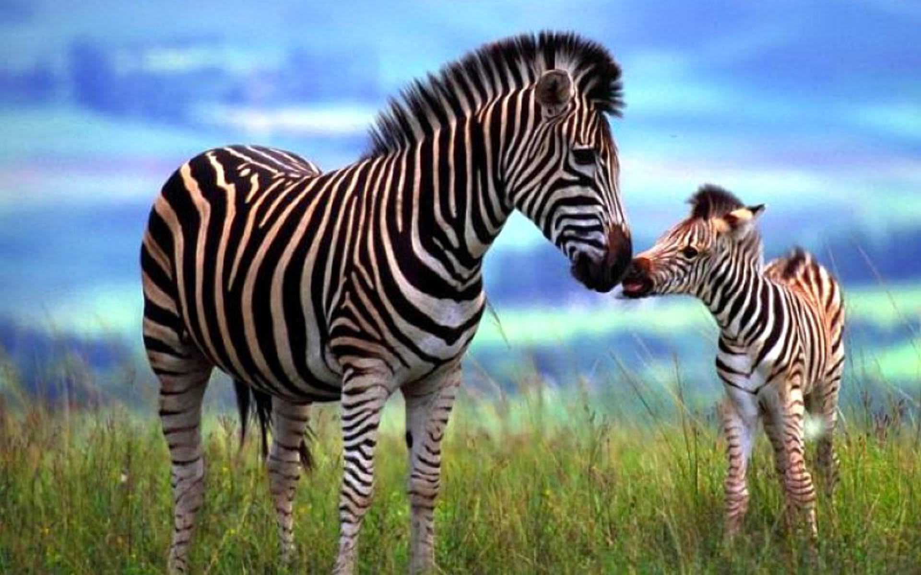
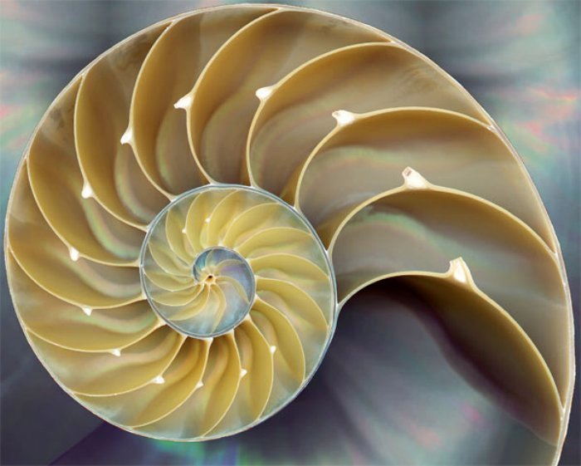
What Is a Pattern?
https://www.youtube.com/watch?v=QOGCSBh3kmM

Slide 10
Where are Patterns?
Draw an Engineer
Animals in the Wild
Academic Fields!
Where Else?

Slide 11

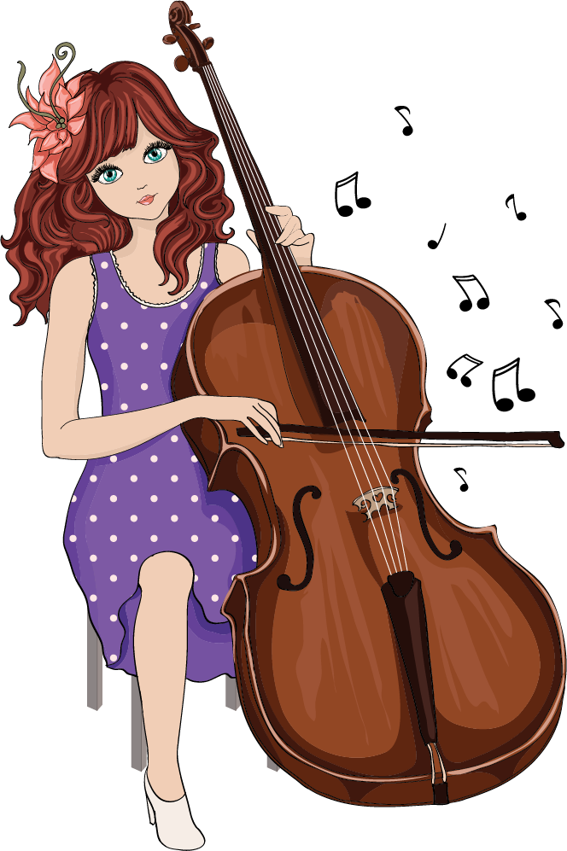
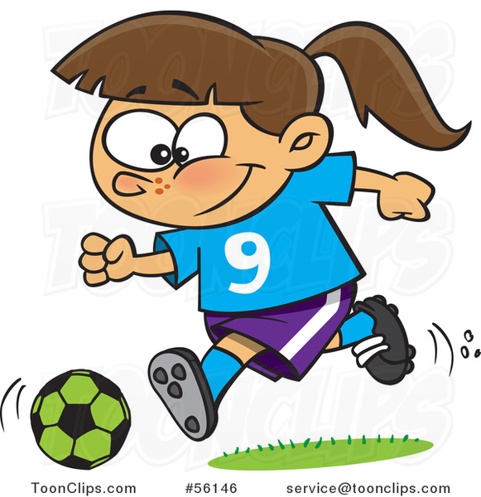
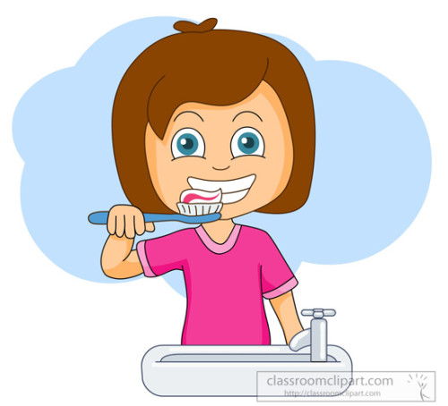
Patterns in Everyday Life
Dancing
Playing an instrument
Playing a sport
Cooking
Brushing your teeth
Finding Something

Slide 12
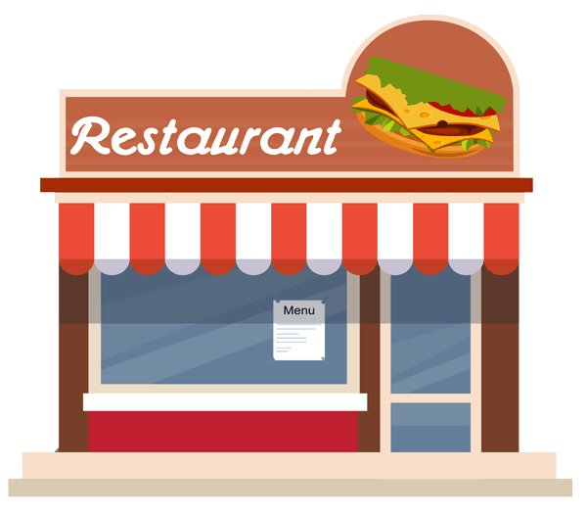


Imagine You’re at a Restaurant...

Slide 13
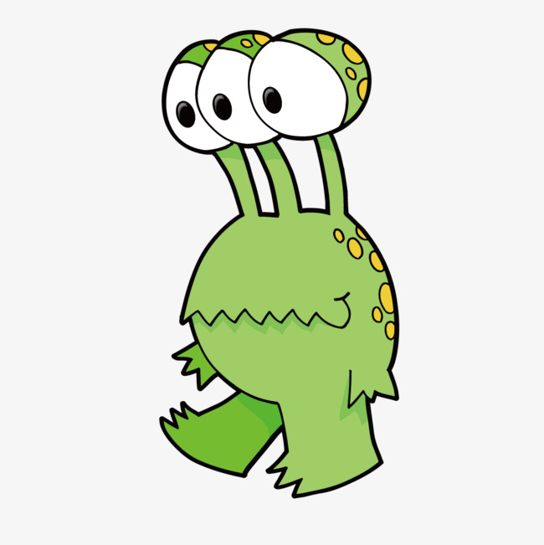
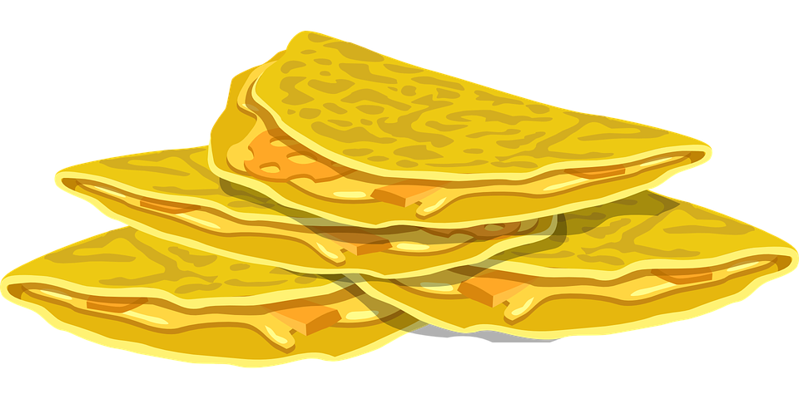
Making a Quesadilla
An alien has landed in Guadalajara!!! He is very hungry but knows nothing about human cooking methods. Write a detailed quesadilla recipe in ten steps or less, using only 20 distinct words.
Notes:
(if we have time… If we’re running behind, then no)
Example: Take tortilla out of bag. Put tortilla on pan. Take 2 scoops cheese out of bag. Put cheese on tortilla in pan. Cook for 5 minutes. Turn tortilla. You can write this on the board...

Slide 14
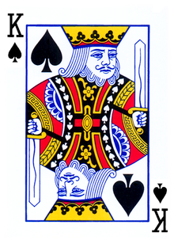
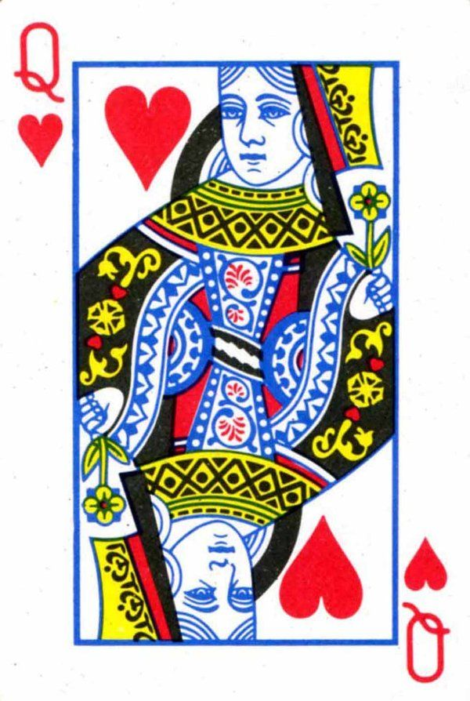
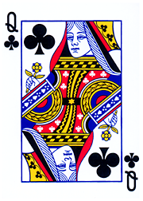
Maximizing Happiness
The Queen of Hearts loves the King of Spades, who loves the Queen of Clubs.
How can we make everyone happy?

Slide 15
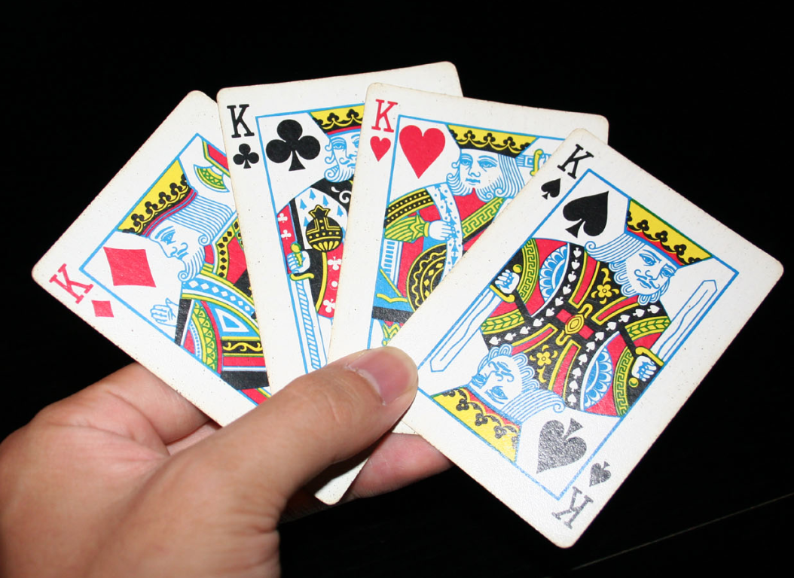
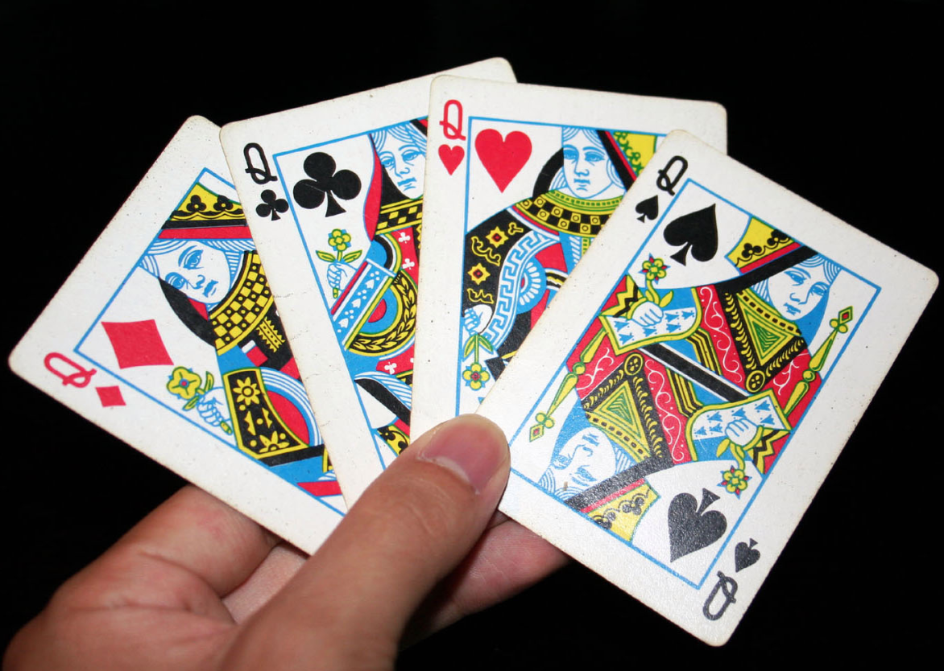
Scenario: Match-Making Pairs
Happiness = # points
1st choice - 4 points
2nd choice - 3 points
3rd choice - 2 points
4th choice - 1 point
Make pairs that maximize total number of points for all 8 cards!

Slide 16
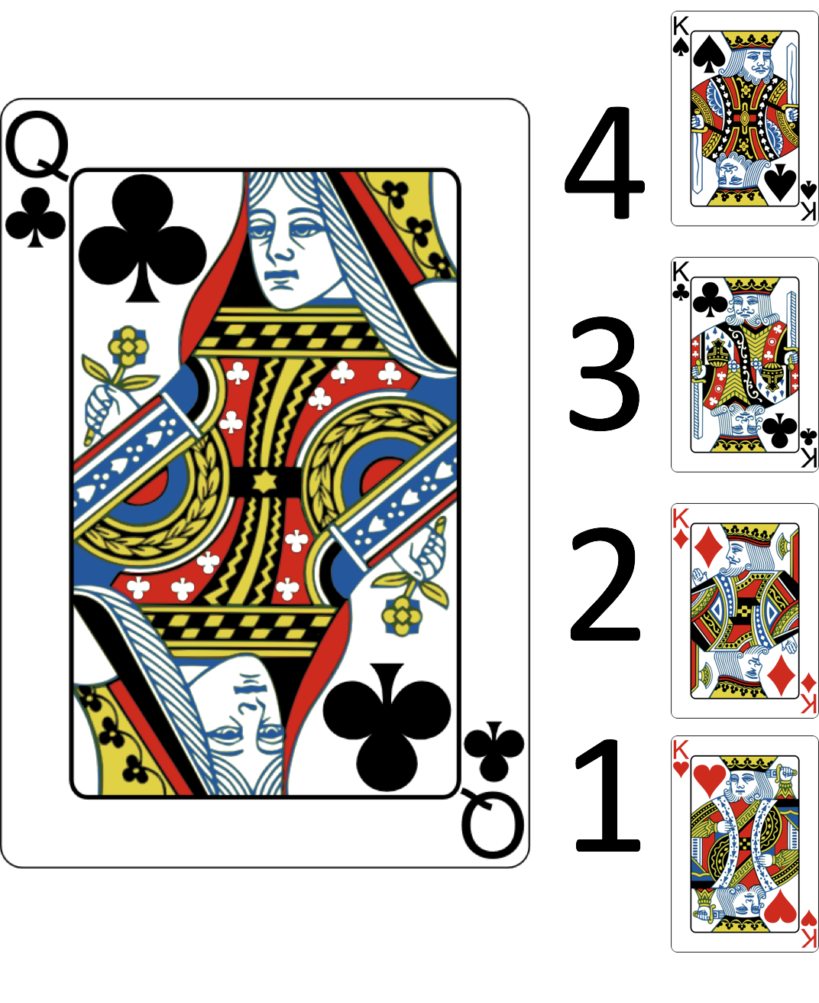
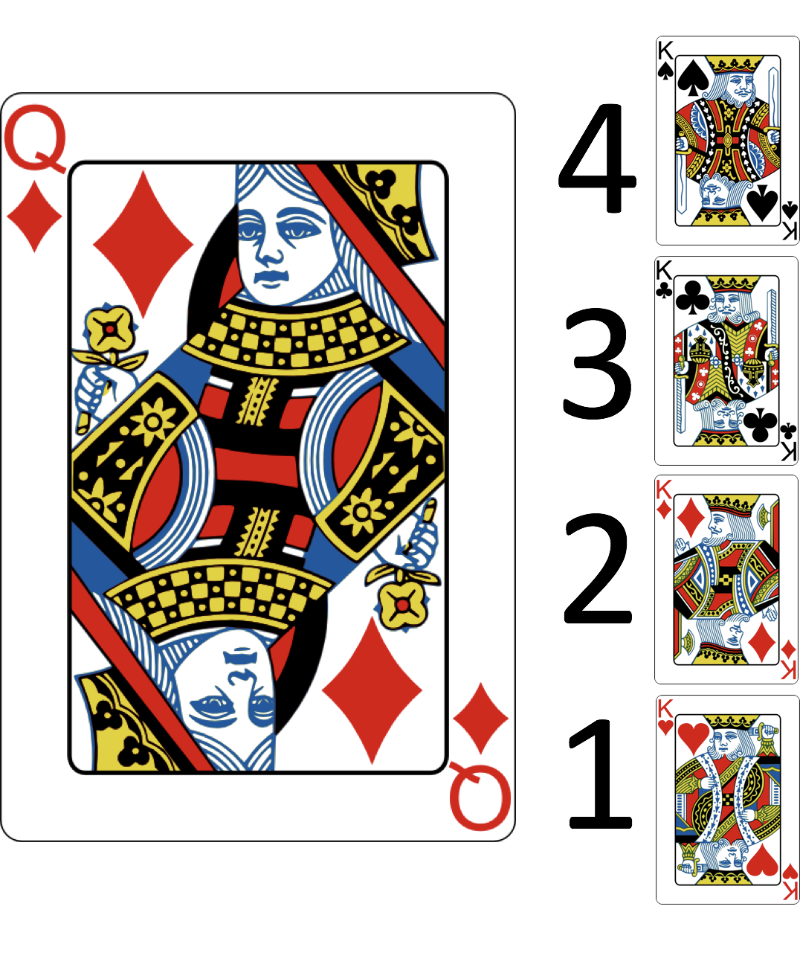

Slide 17
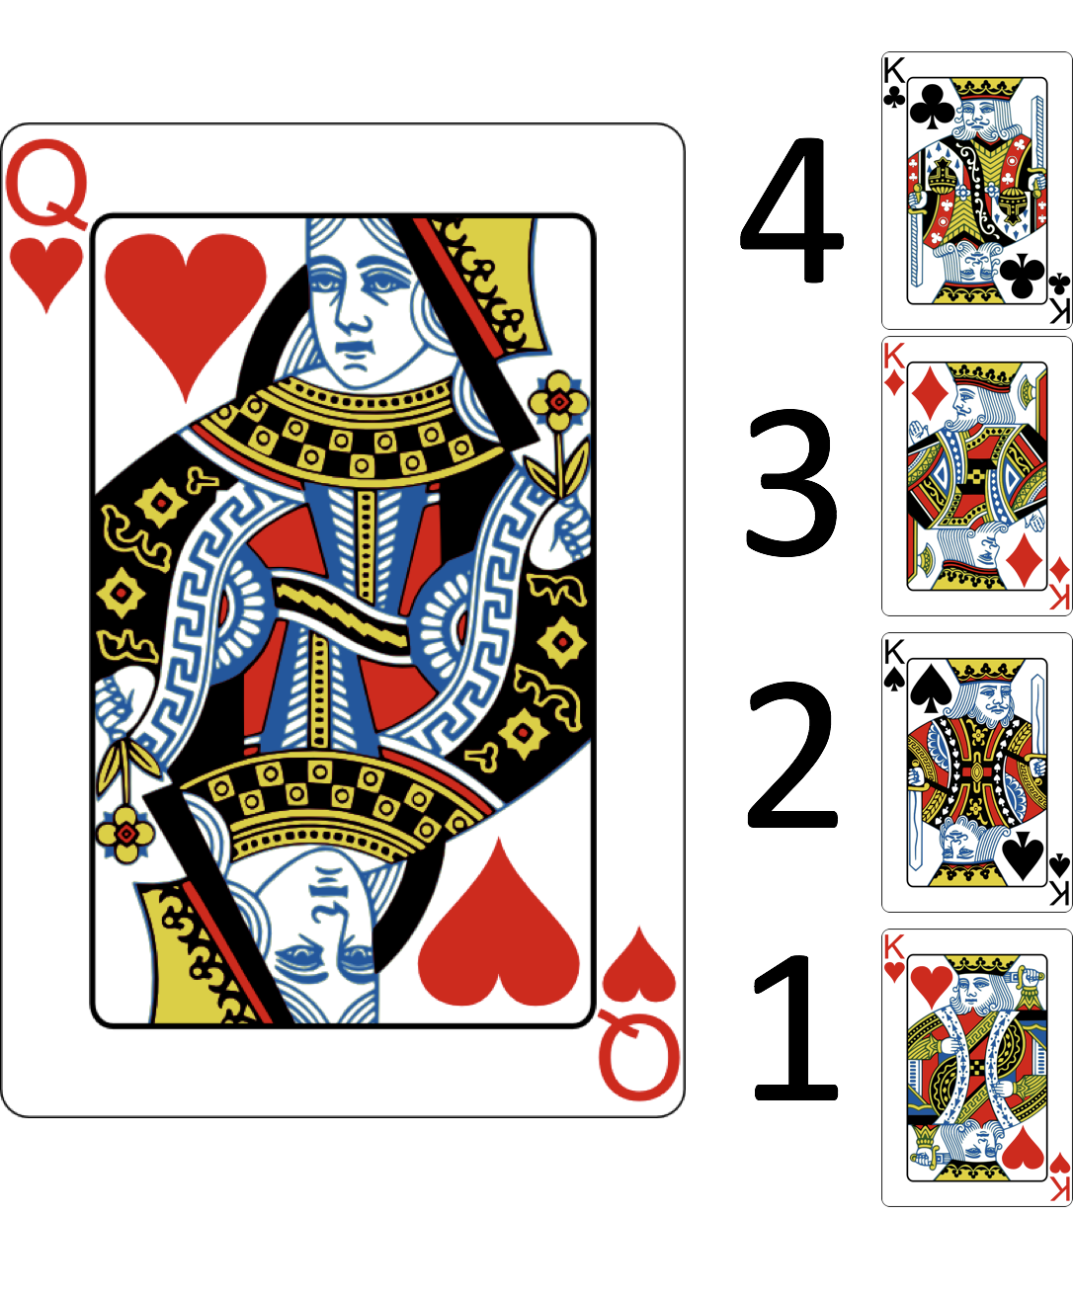
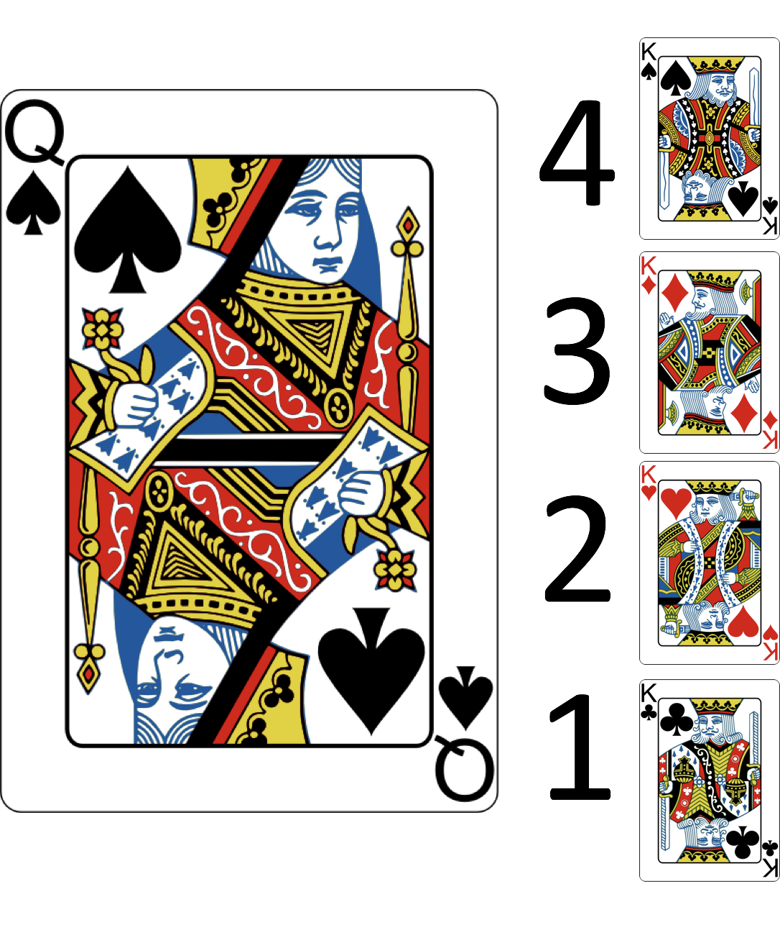

Slide 18
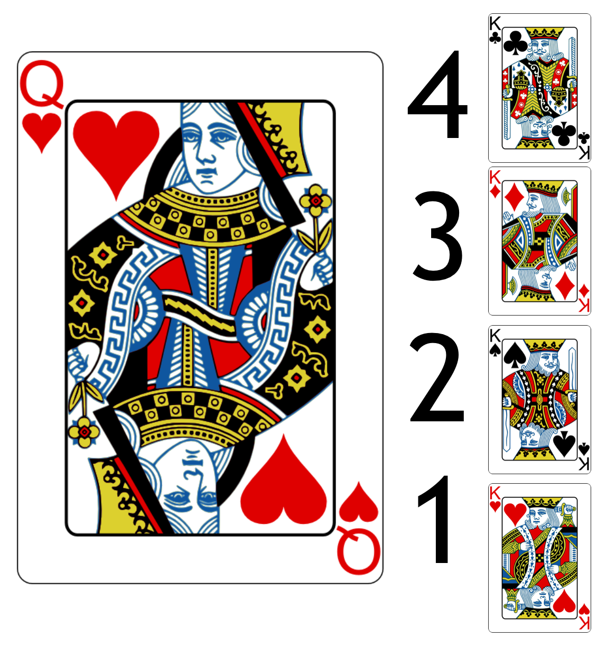
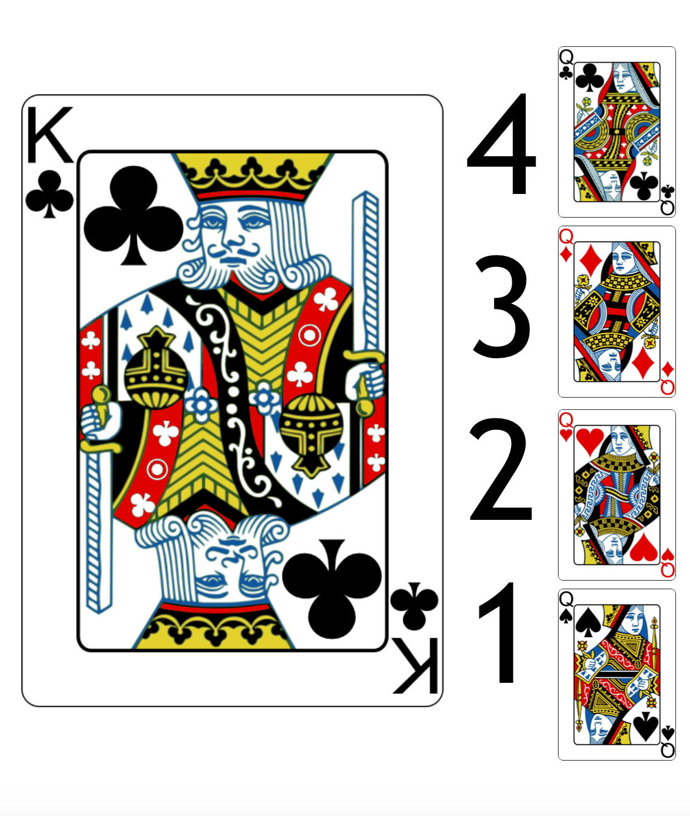
Example
6

Slide 19
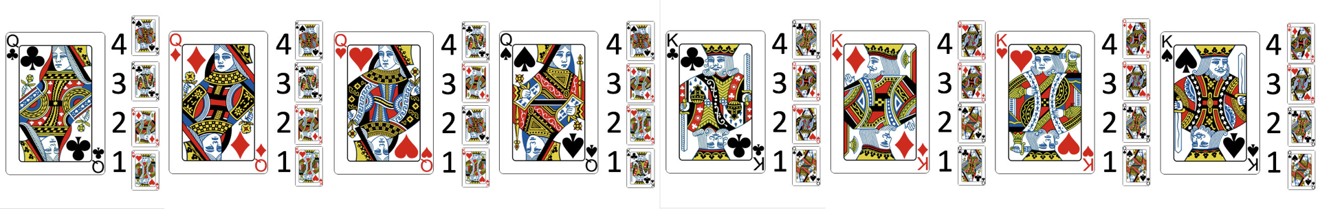

Slide 20
Notes:
solution!

Slide 21
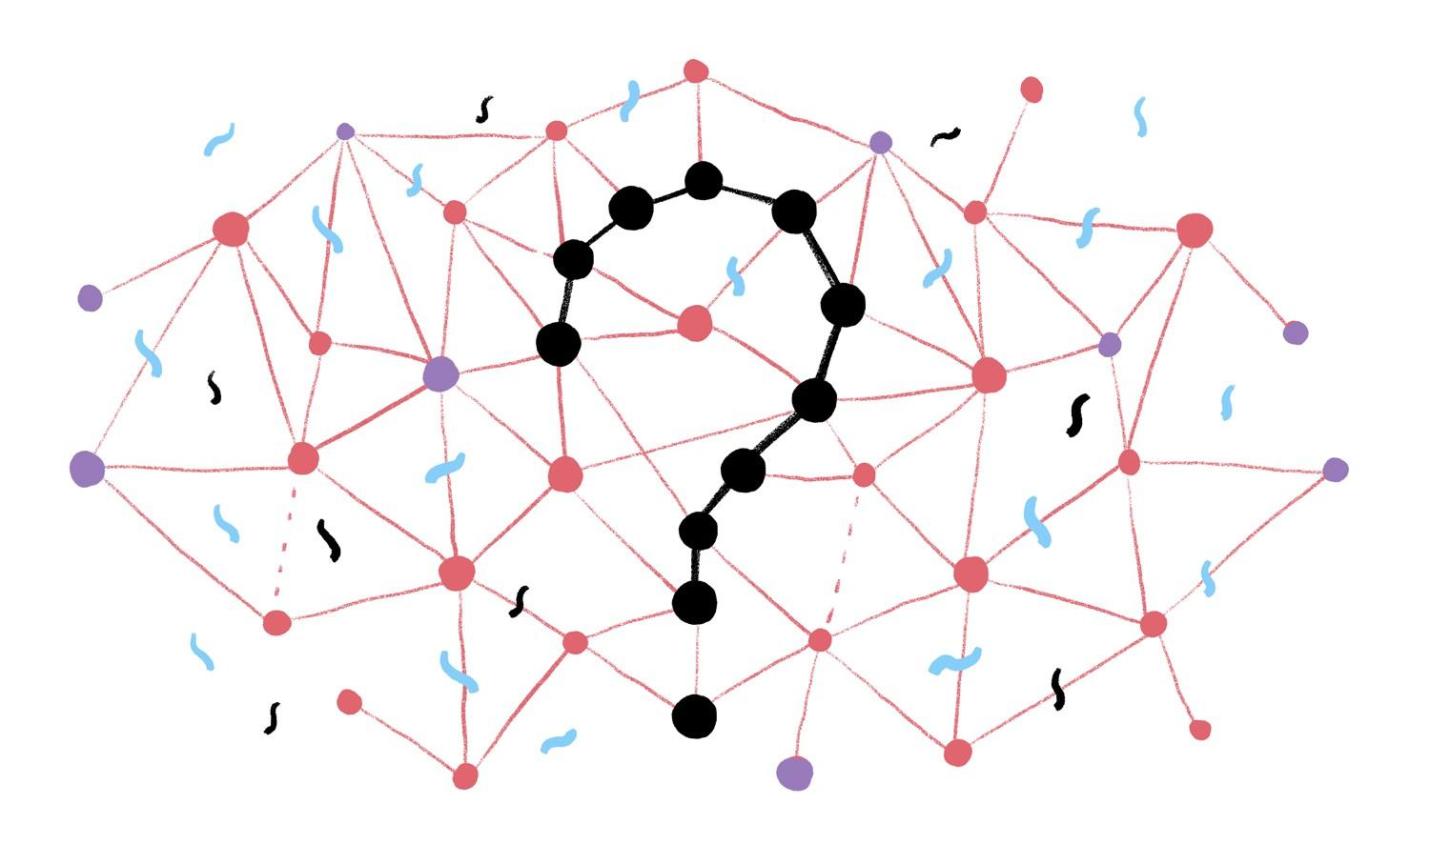
The Gale-Shapley Algorithm

Slide 22
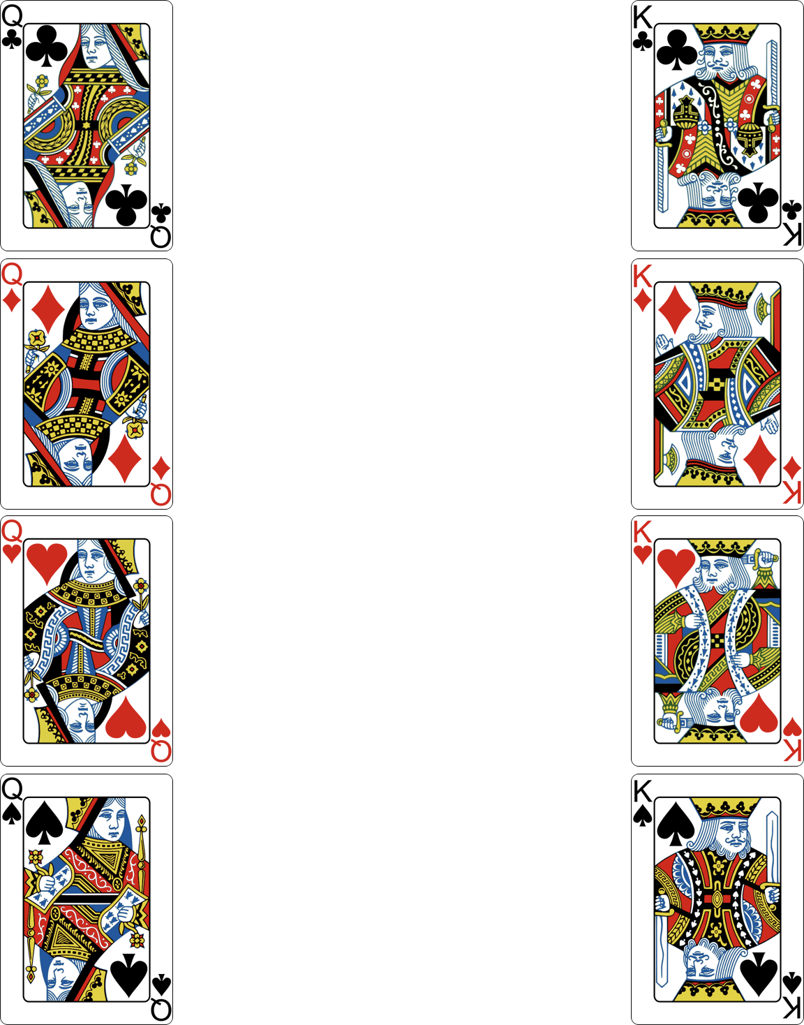

Slide 23
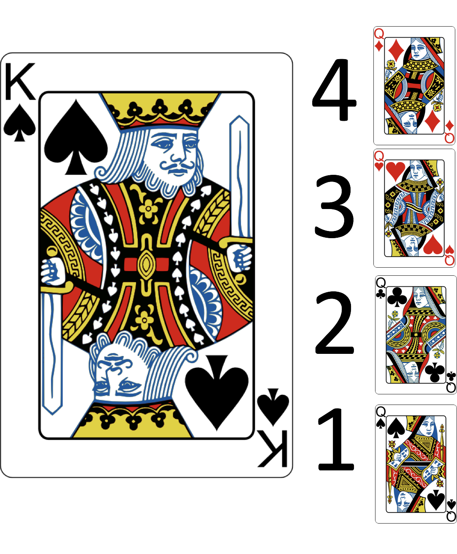



Slide 24
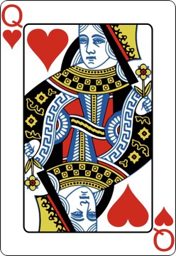
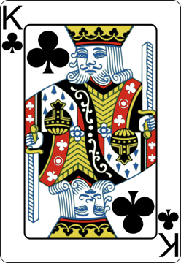
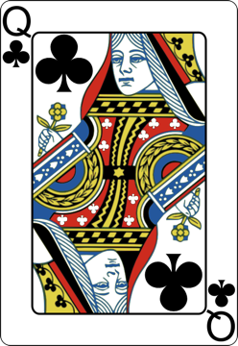
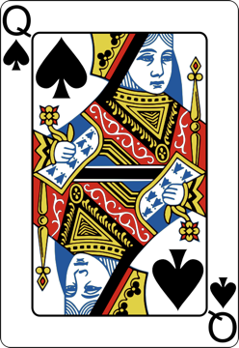
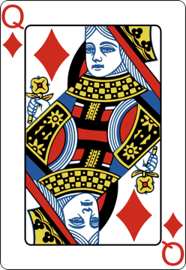
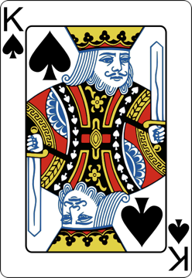
?
?

Slide 25
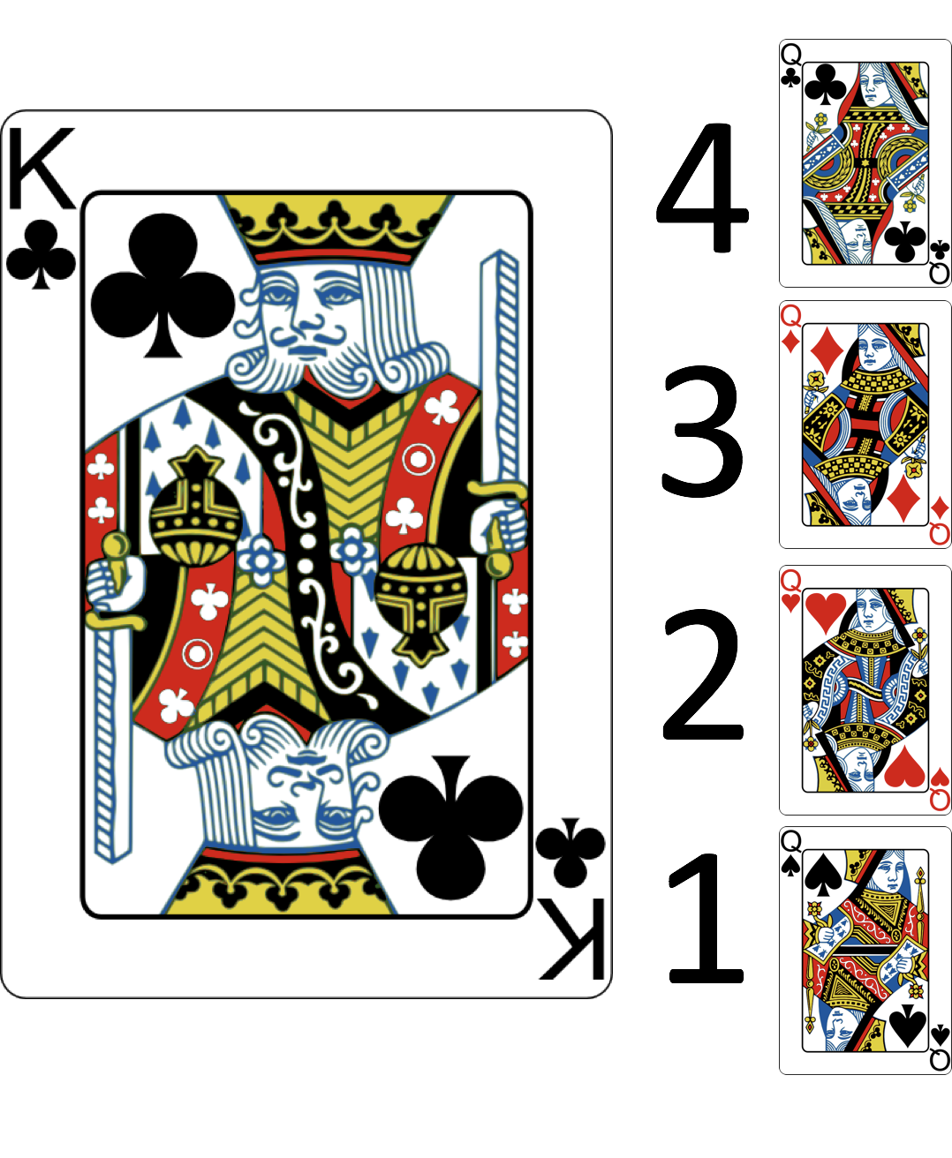


Slide 26
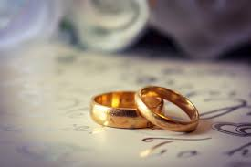
We continue the pattern until the final pairings. At this point, all the marriages are the happiest they can be!
How could you apply this process to other situations?

Slide 27
Your Turn to Apply Gale-Shapley!
Explain a real life problem
Explain how you can apply Gale-Shapley to this problem
Present your idea to the class!

Slide 28

If you were to write a book, what would it be about?

Slide 29
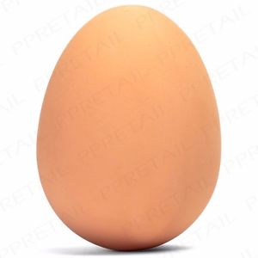
What Is a Function?
Notes:
Ask what are different things we can do to an egg?

Slide 30
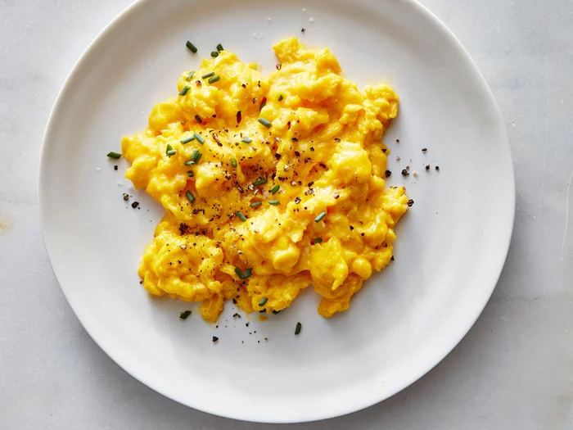
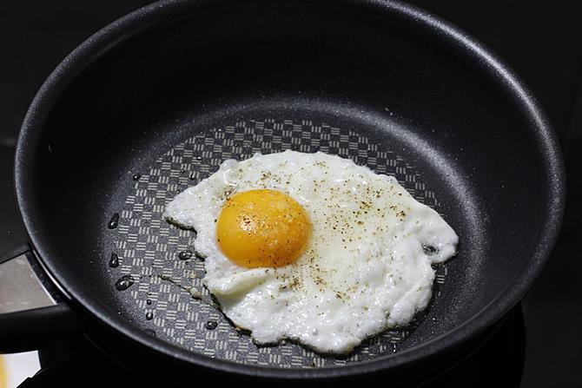
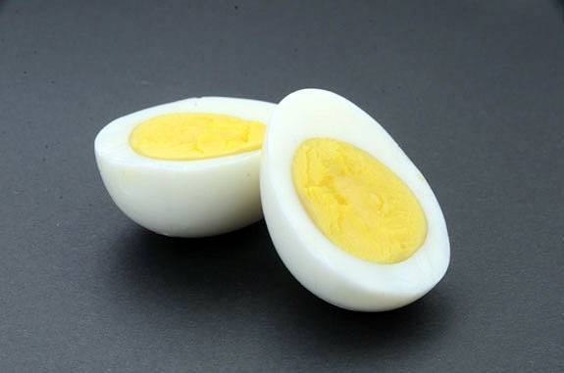
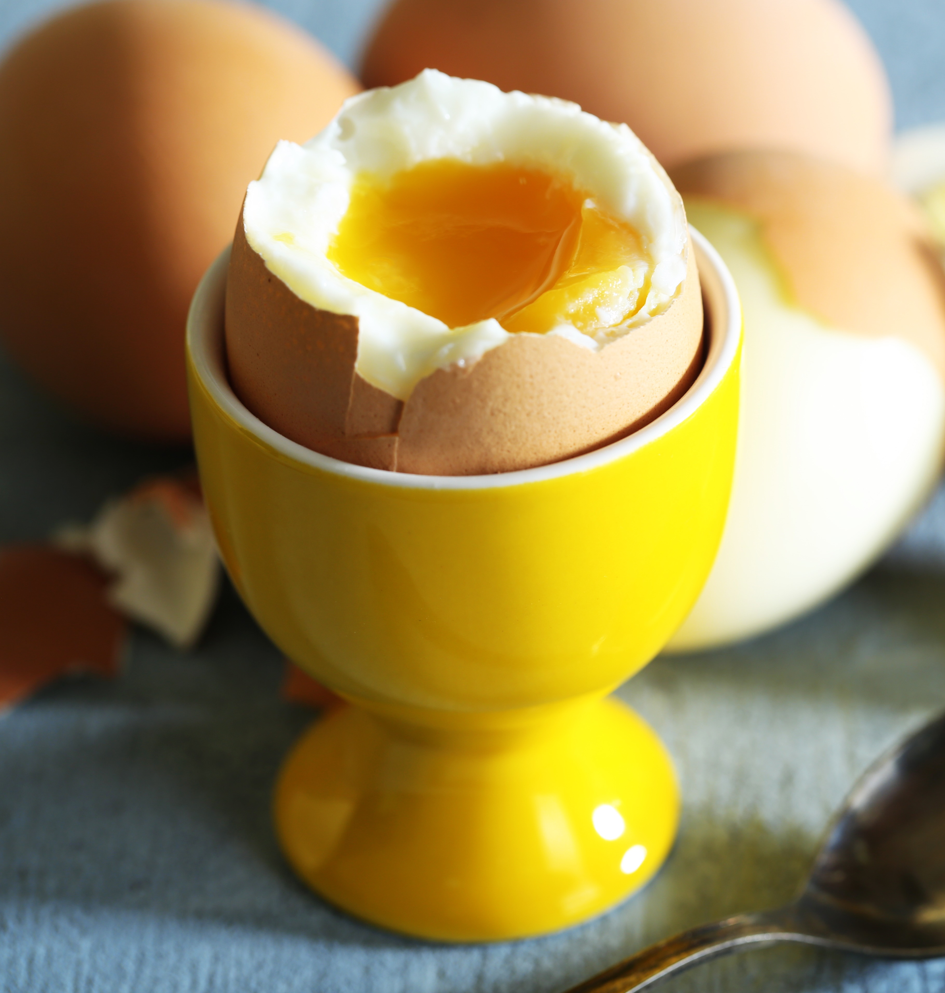
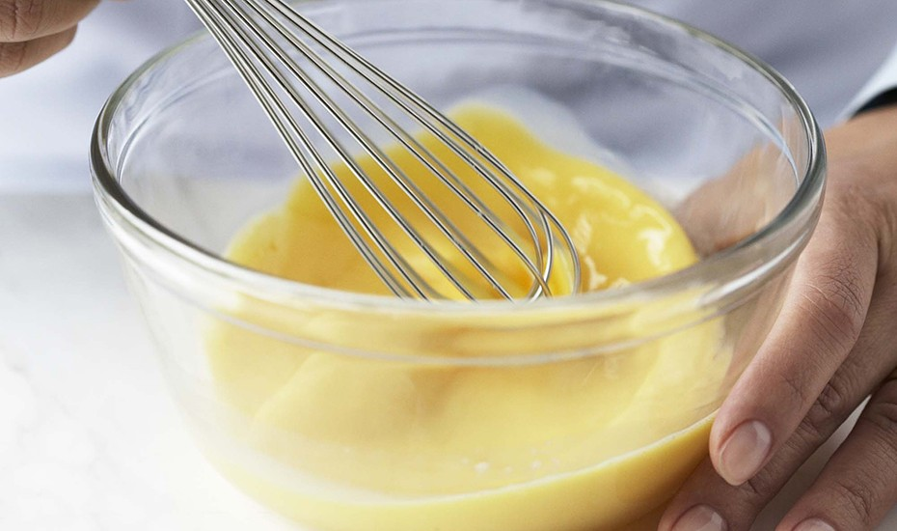
Egg Functions
scramble()
fry()
hard-boil()
soft-boil()
whisk()
Notes:
Ask what are different things we can do to an egg?

Slide 31
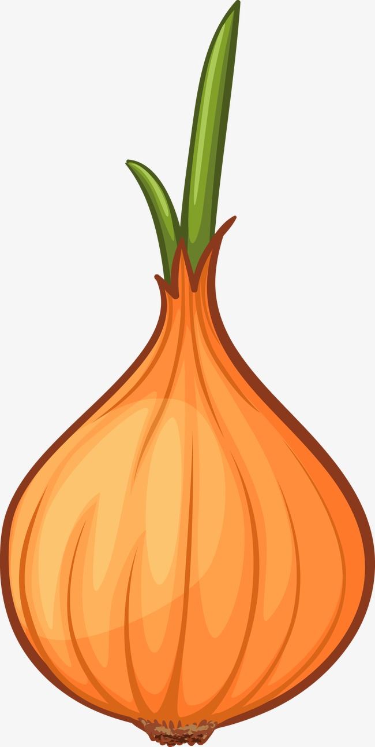

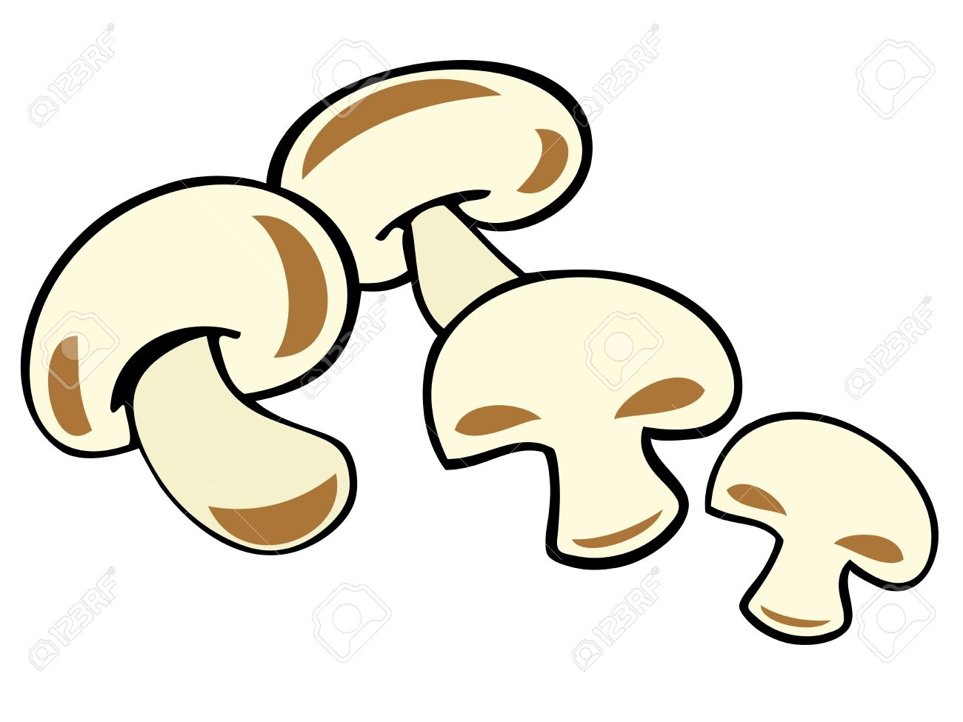
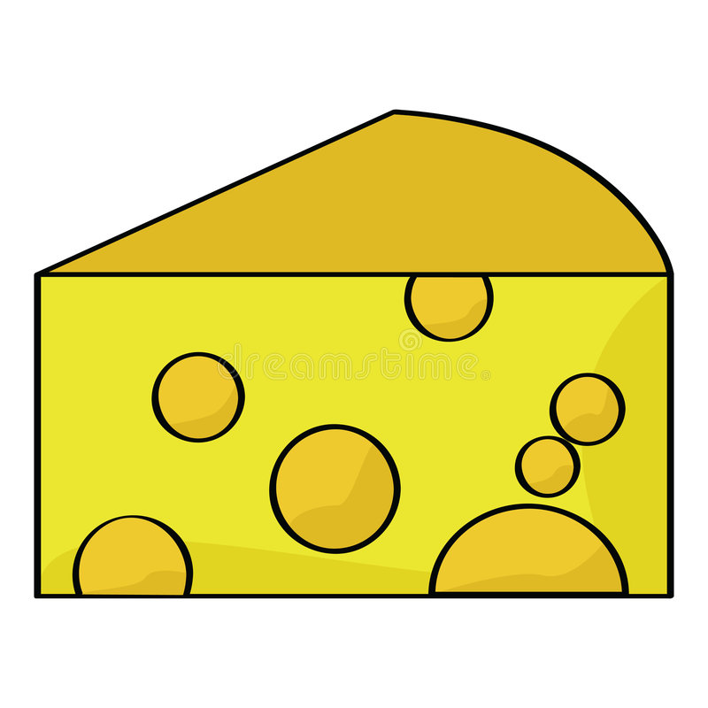
Egg Functions
scramble(onions, peppers)
scramble(mushrooms)
fry(cheese)
Notes:
Ask what are different things we can do to an egg?

Slide 32
How does a computer work?
Remember the restaurant
We write instructions
Computer interprets instructions

Slide 33
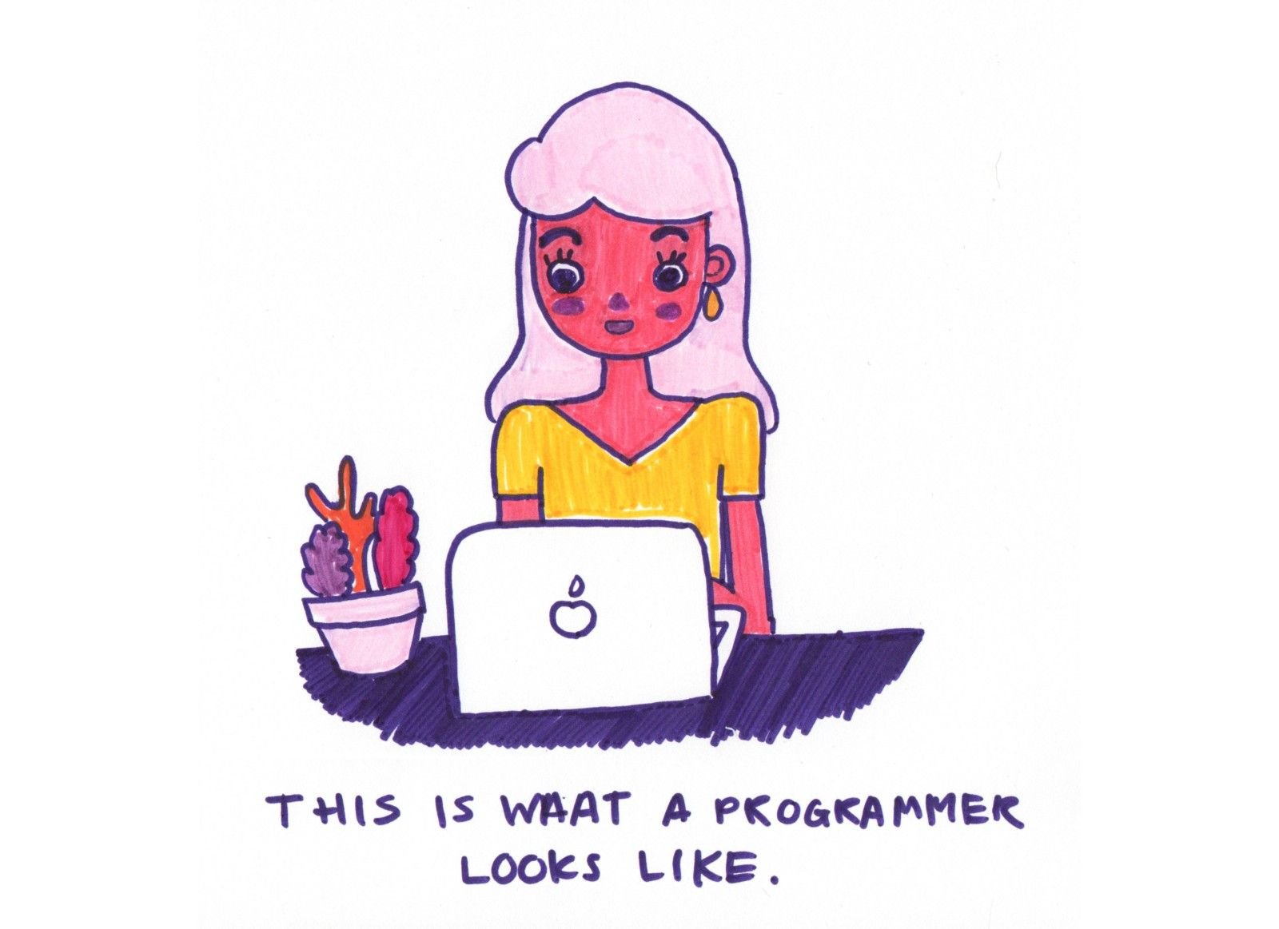
Coding Exercises

Slide 34
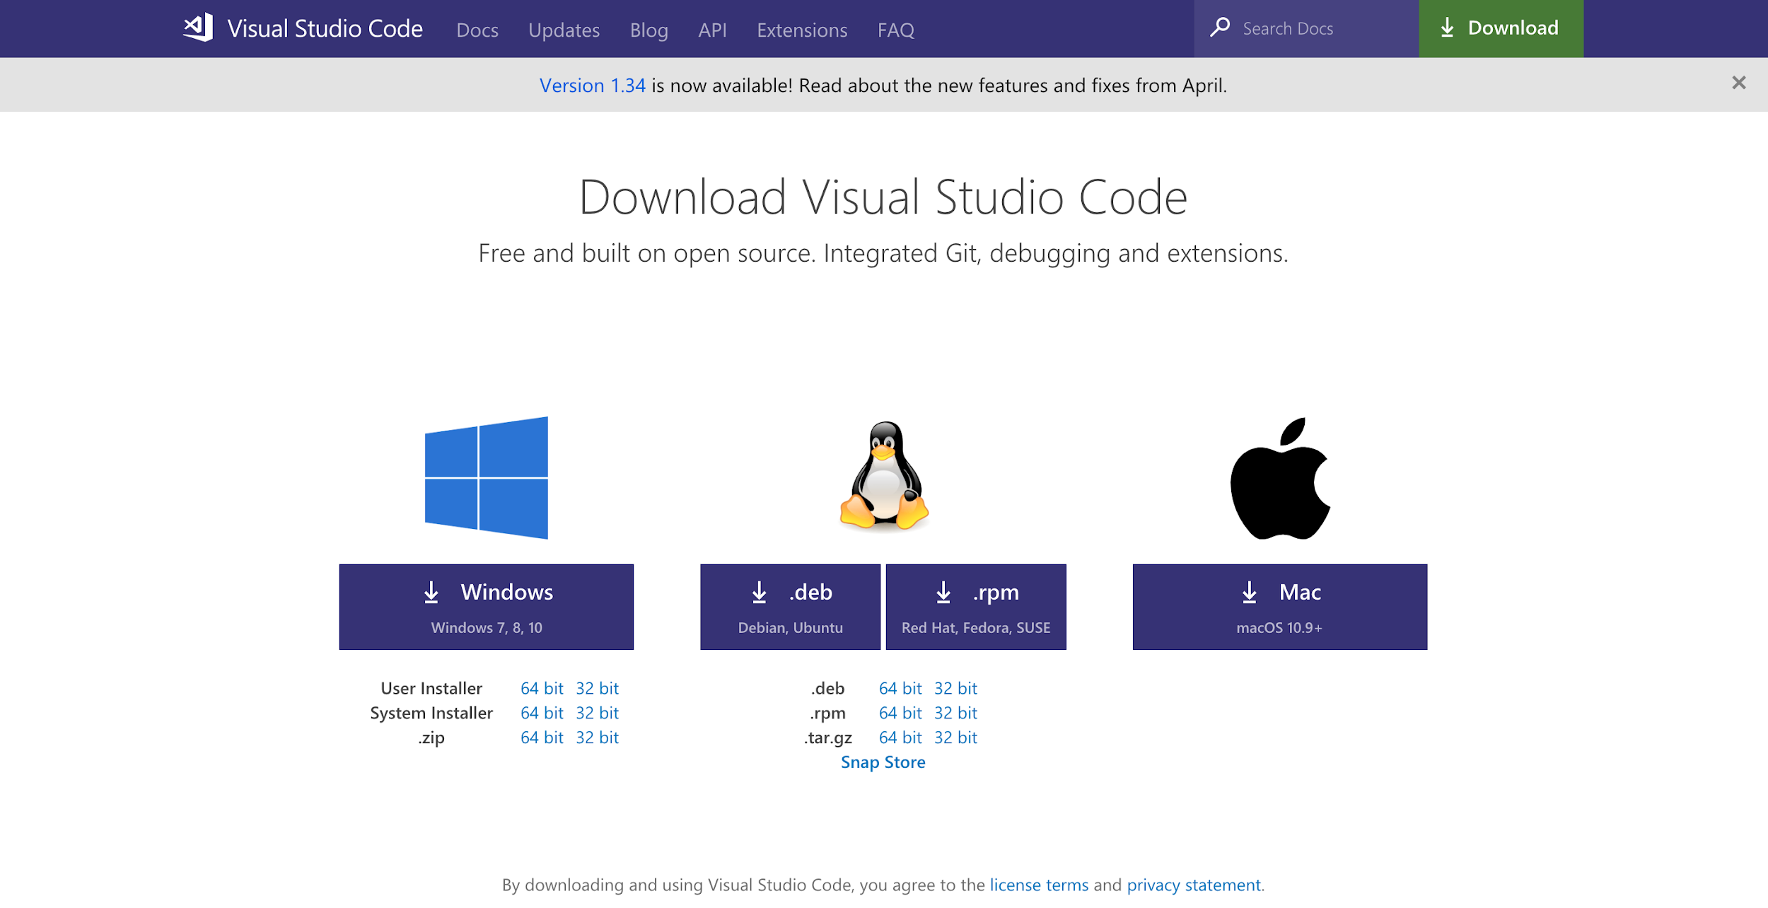
Download Visual Studio Code

Slide 35
Let’s Build a Website!!!
Go to: https://dreamgrande.io/workshop
Go to Monday

Slide 36
Basic Elements of a Webpage
HTML
CSS
Screen coordinate system
Z-Index
DIV properties

Slide 37
Hello World!

Slide 38

Final Project Brainstorming

Slide 39
End of Day Task - Reflection

